Slide 1
Caeser Cypher

Slide 2
Types of Encryption Tecniques
1.Substituion Technique
2.Transposition Technique

Slide 3
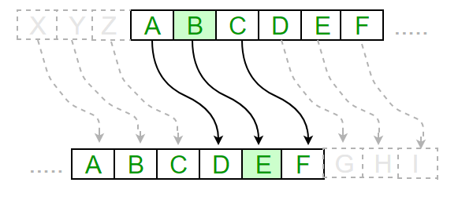
Substitution
I

Slide 4
Text : ABCDEFGHIJKLMNOPQRSTUVWXYZ
Shift: 23
Cipher: XYZABCDEFGHIJKLMNOPQRSTUVW
Text : ATTACKATONCE
Shift: 4
Cipher: EXXEGOEXSRGI

Slide 5
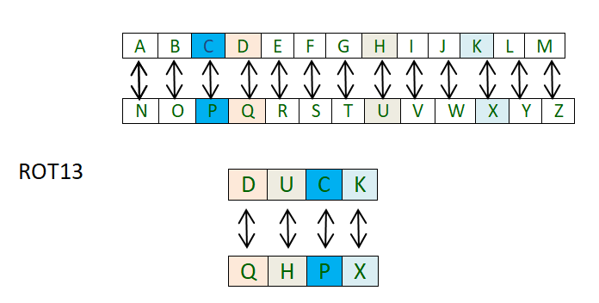
Rot13

Slide 6
Double Transpositions Cypher

Slide 7
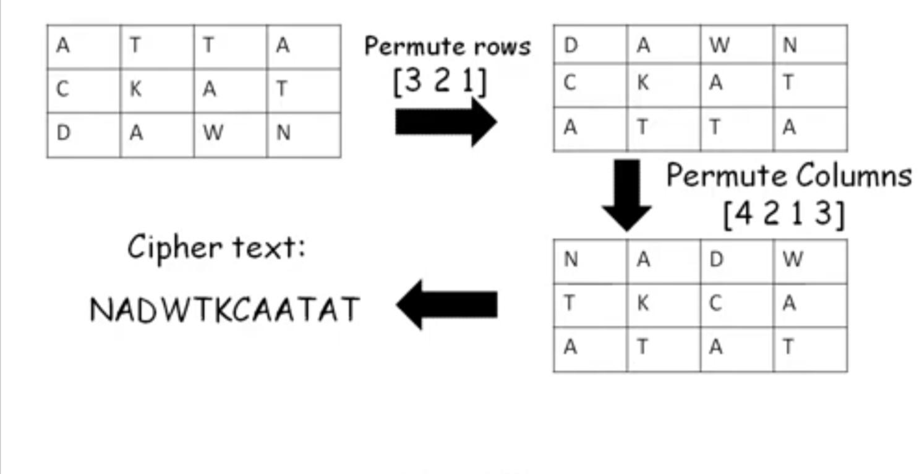
Double Transpositions Cypher

Slide 8
Thank you

